Slide 1
More with AC/DC
Fill this out pls: https://forms.gle/fu8nNQp2nD2BBT2B6

Slide 2
Past concepts

Slide 3
Hard concepts
EMF: stands for the electromotive force (we can think of this as the same thing as voltage)
Induction: changing current can produce a magnet, and changing the position of a magnet can produce a current

Slide 4
Definitions
Power law: P = IV (the more current and the more voltage means the more power)
DC: direct current (the current always flows in a single direction)
AC: alternating current (the current will change direction periodically)

Slide 5
Alternators

Slide 6
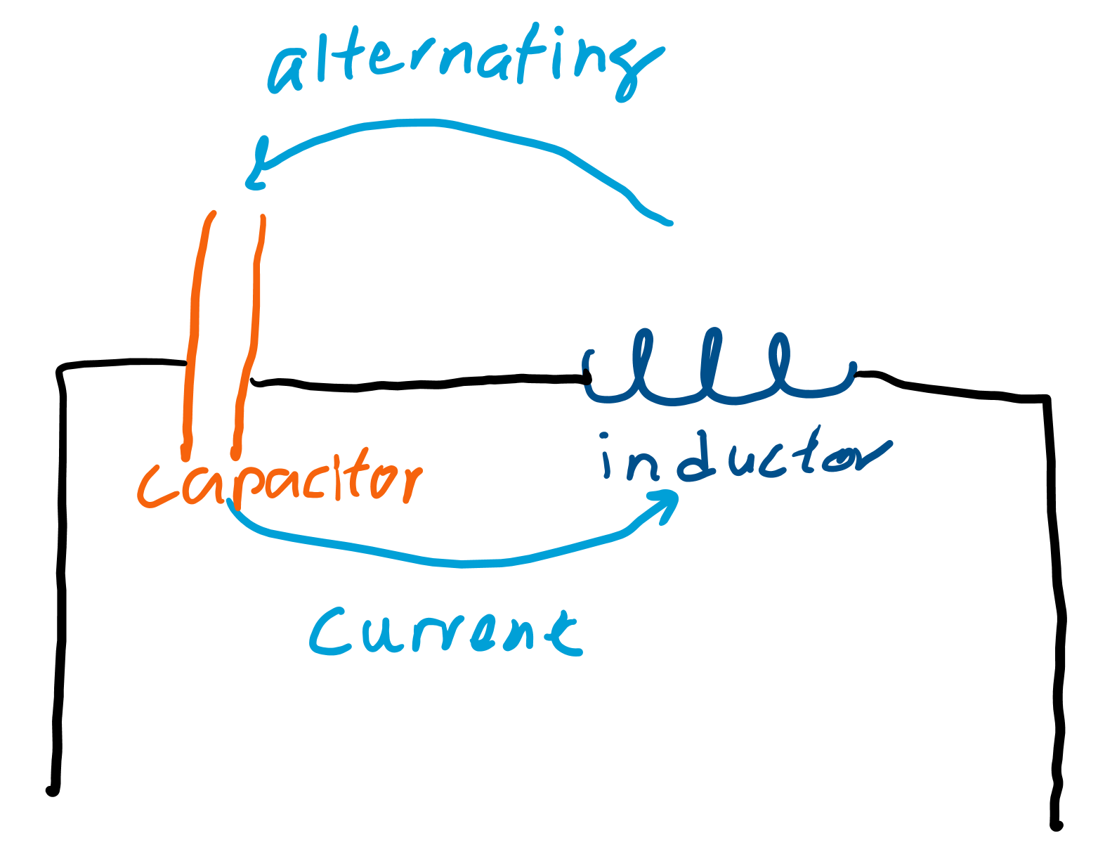
What do alternators do?
What kind of current do you think an alternator generates?
How did we make alternating currents with resistors, inductors, and capacitors?
How did inductors store energy? What about capacitors?

Slide 7
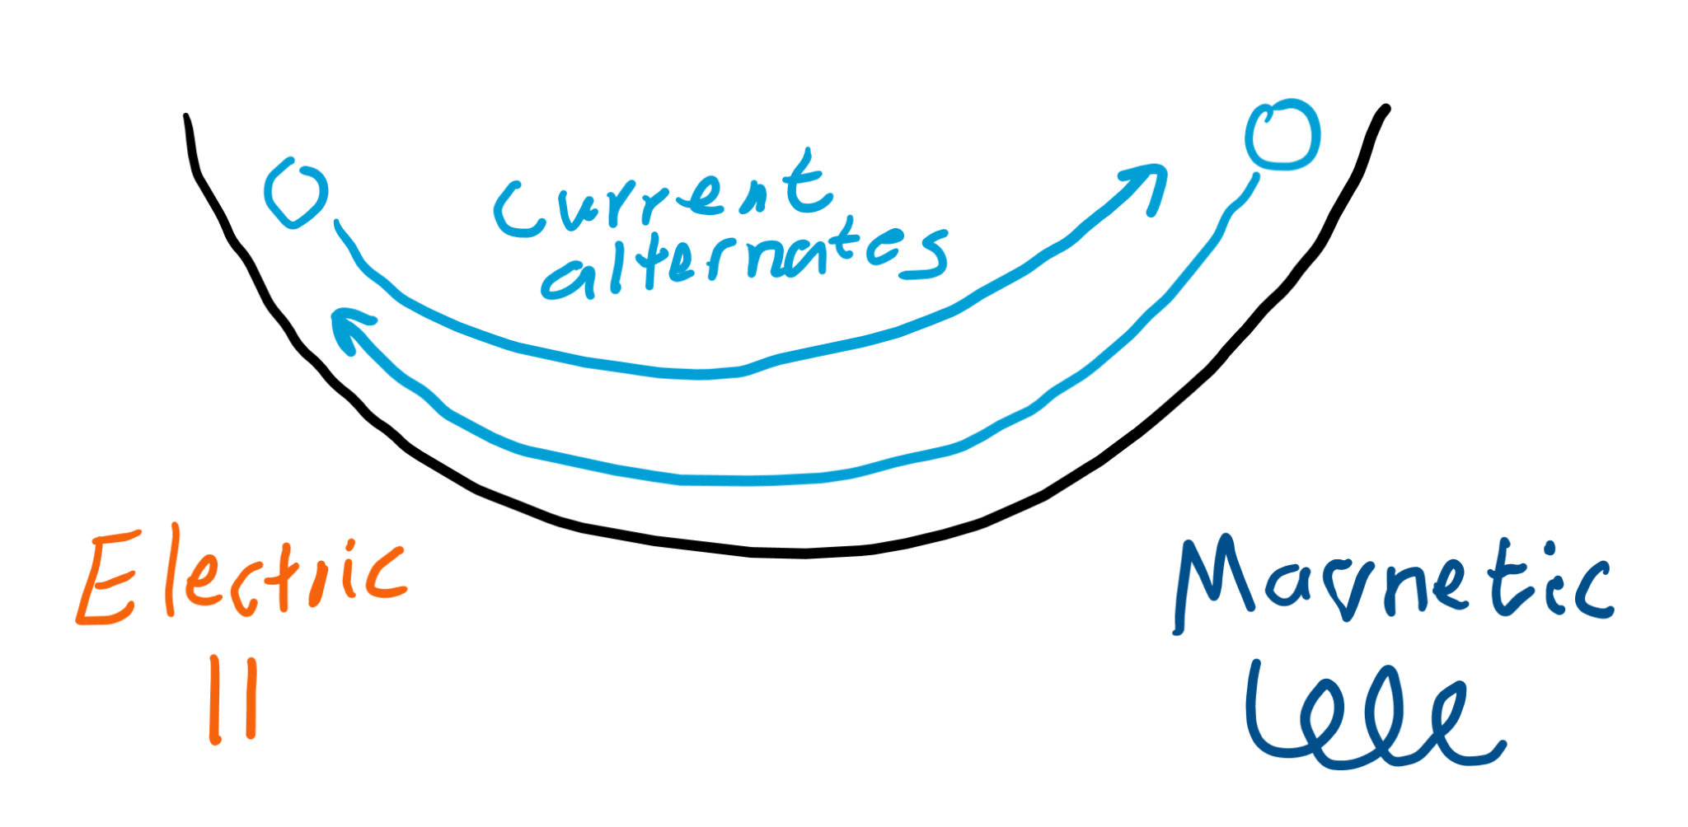
How alternators work
Like LC (inductor-capacitor) circuits, alternators use the magnetic field to alternate the direction of the electric current.

Slide 8
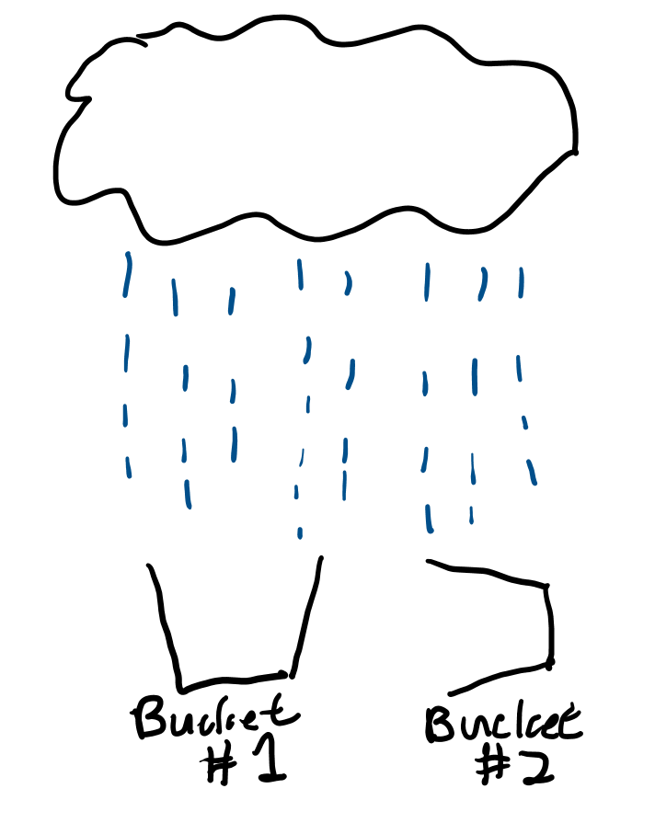
Catching rain
Let’s say we have a bucket. How should we turn our bucket so we can catch the most rain?

Slide 9
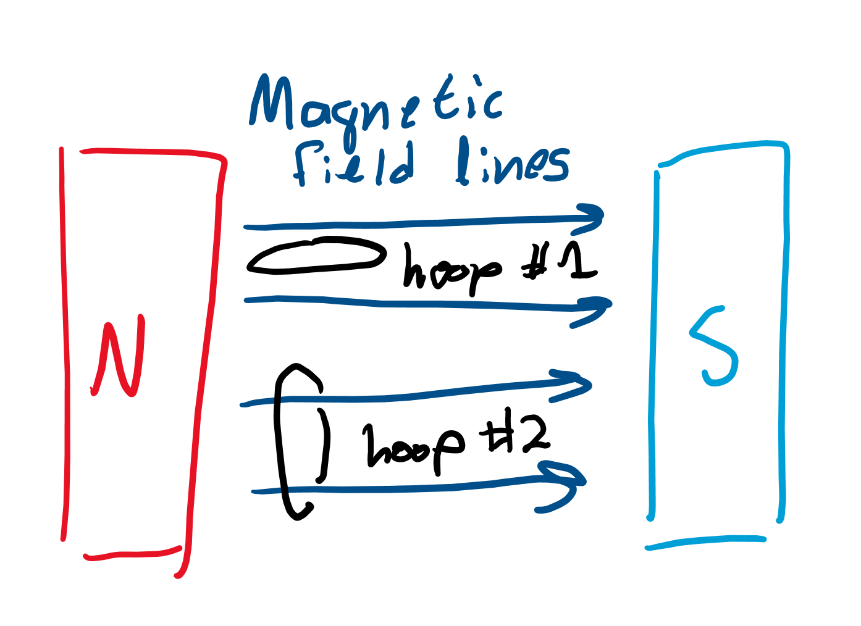
“Catching” magnetic field lines
If we turn our hoop of wire (acting as our bucket) to face the field lines (acting as our rain), we maximize the amount of lines we catch.
We measure the amount of magnetism we “catch” as “flux.” Wire 1 has no flux as no field lines are “caught” by it while two fields lines flow through wire 2, so it has flux.

Slide 10
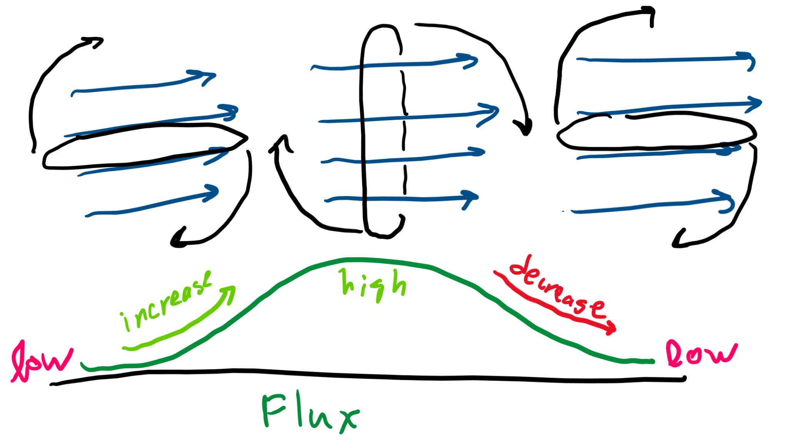
Changing flux
As we turn the hoop around, we first increase, then decrease, the amount of flux we have.
When our flux increases, we induce a current in one direction. When our flux decreases, we induce a current in the other direction. That’s AC!

Slide 11
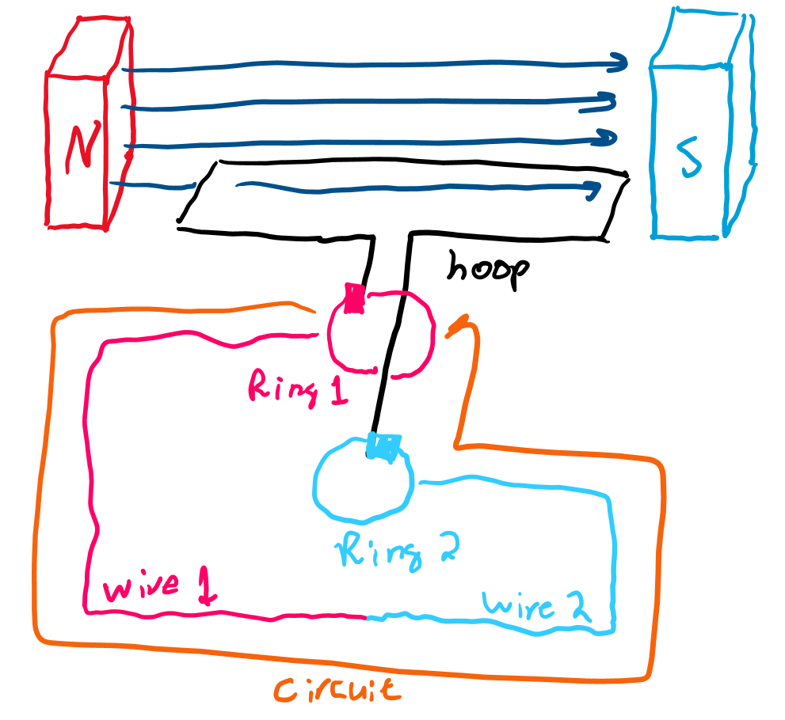
Adding the wires
We put one end of the hoop in one ring and the other in another ring.
One ring connects to one side of the wire of our AC circuit, and the other connects to the other side.

Slide 12
Motors

Slide 13
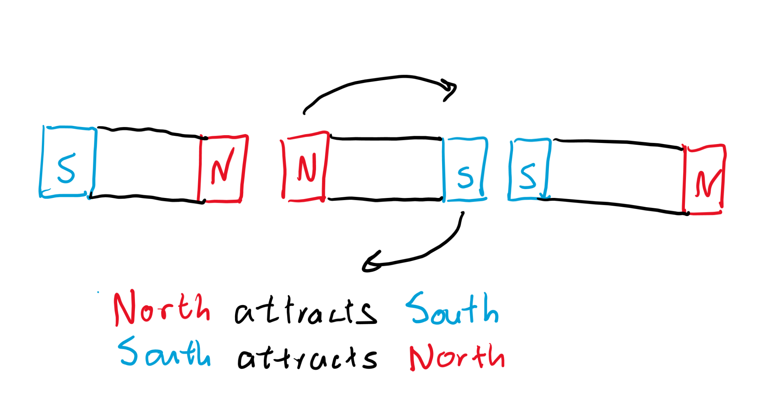
Again, magnets
Imagine three magnets in a row. The one in the middle wants to rotate so that it is in line with the other two.

Slide 14
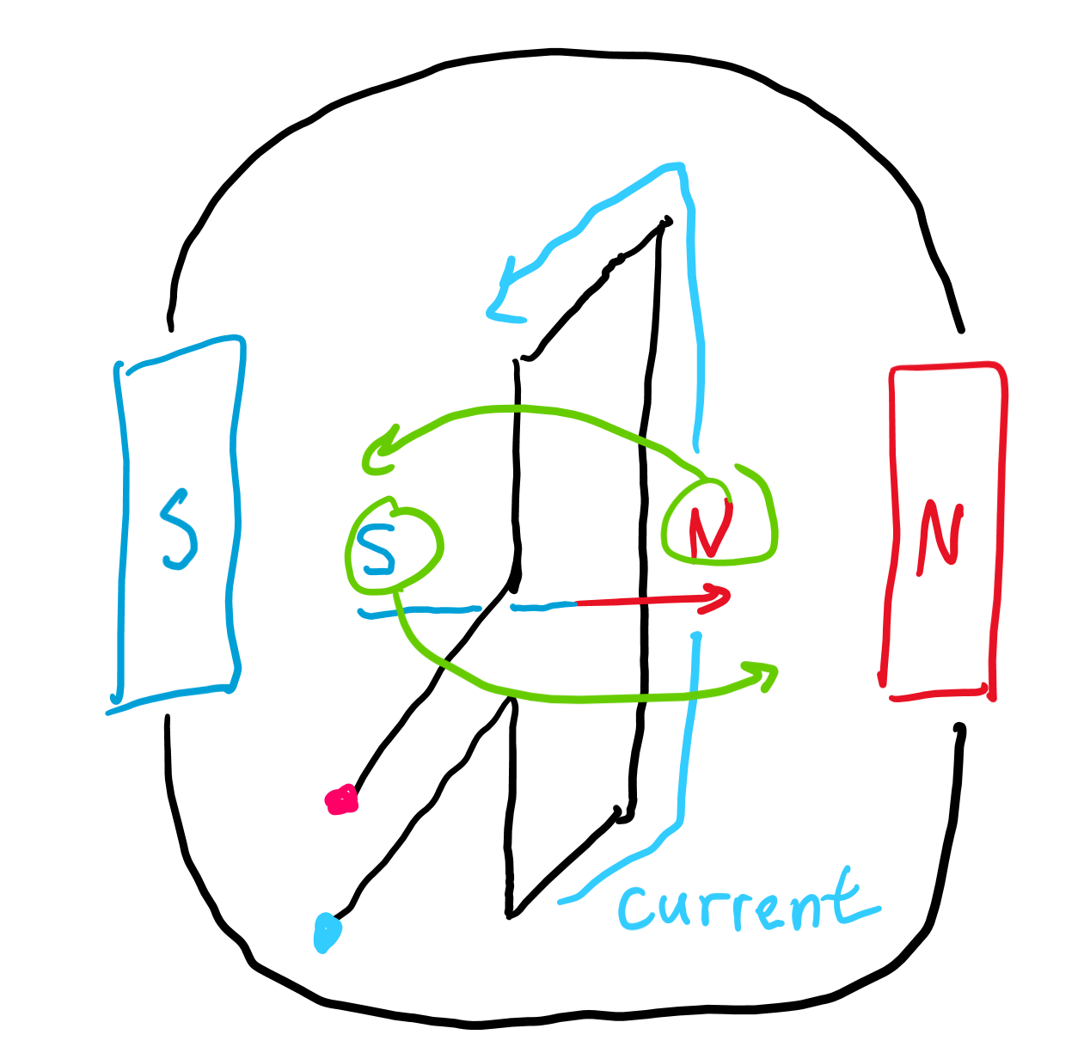
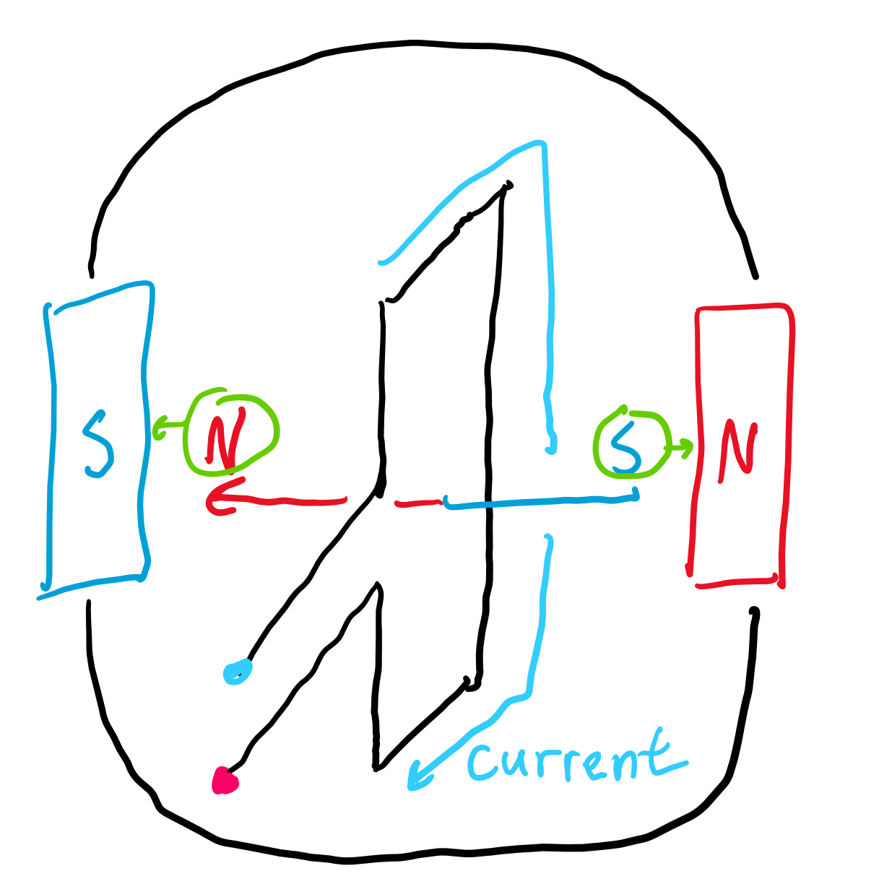
Electromagnetism
We can induce a magnetic field by applying a current on a loop. This loop makes the “magnet in the middle.”
We have to constantly rotate the direction of current if we want this electromagnet to continue spinning.
The diagram on the right shows what happens if the current in the loop always travels from blue to pink (doesn’t change direction). The loop first spins so north and south ends touch, but then it doesn’t want to move.

Slide 15
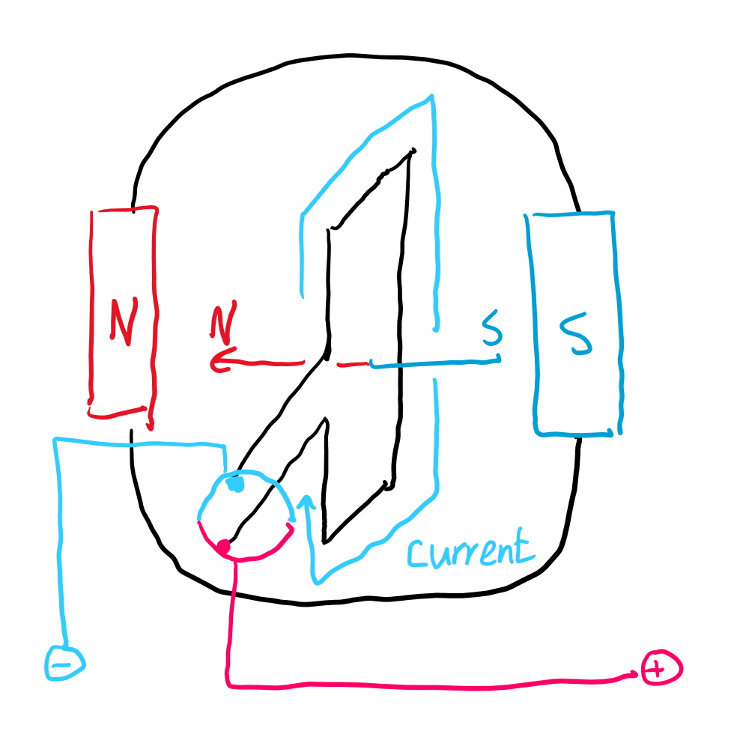
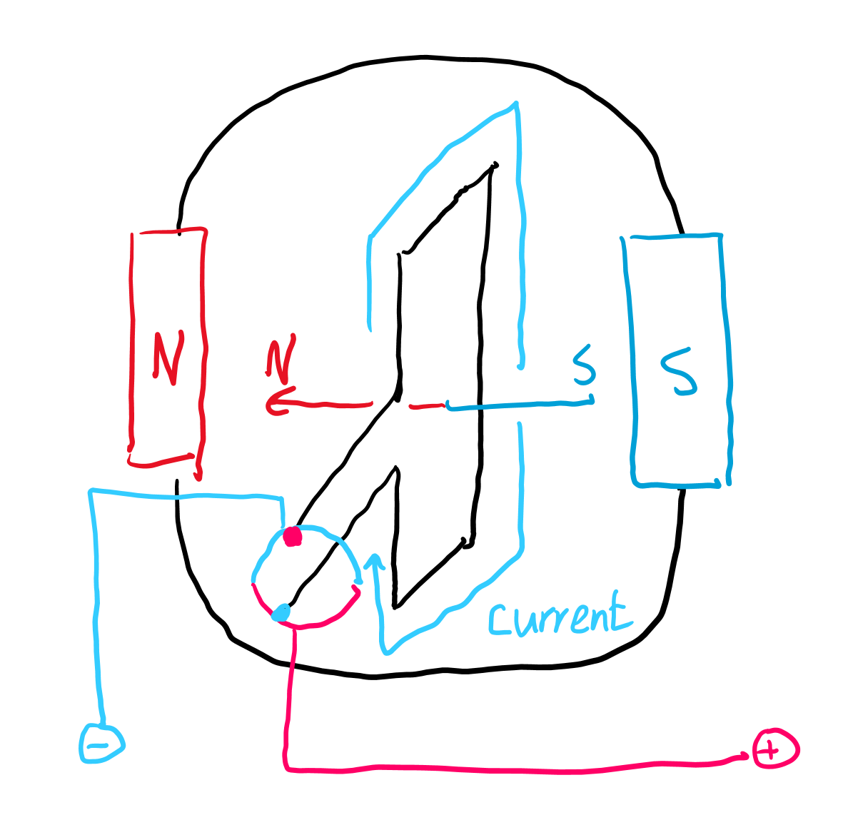
Split ring
One device used to turn DC power into “AC” like power is a split ring.
This causes the current to always make the electromagnet face the wrong way and want to turn.

Slide 16
Transformers

Slide 17
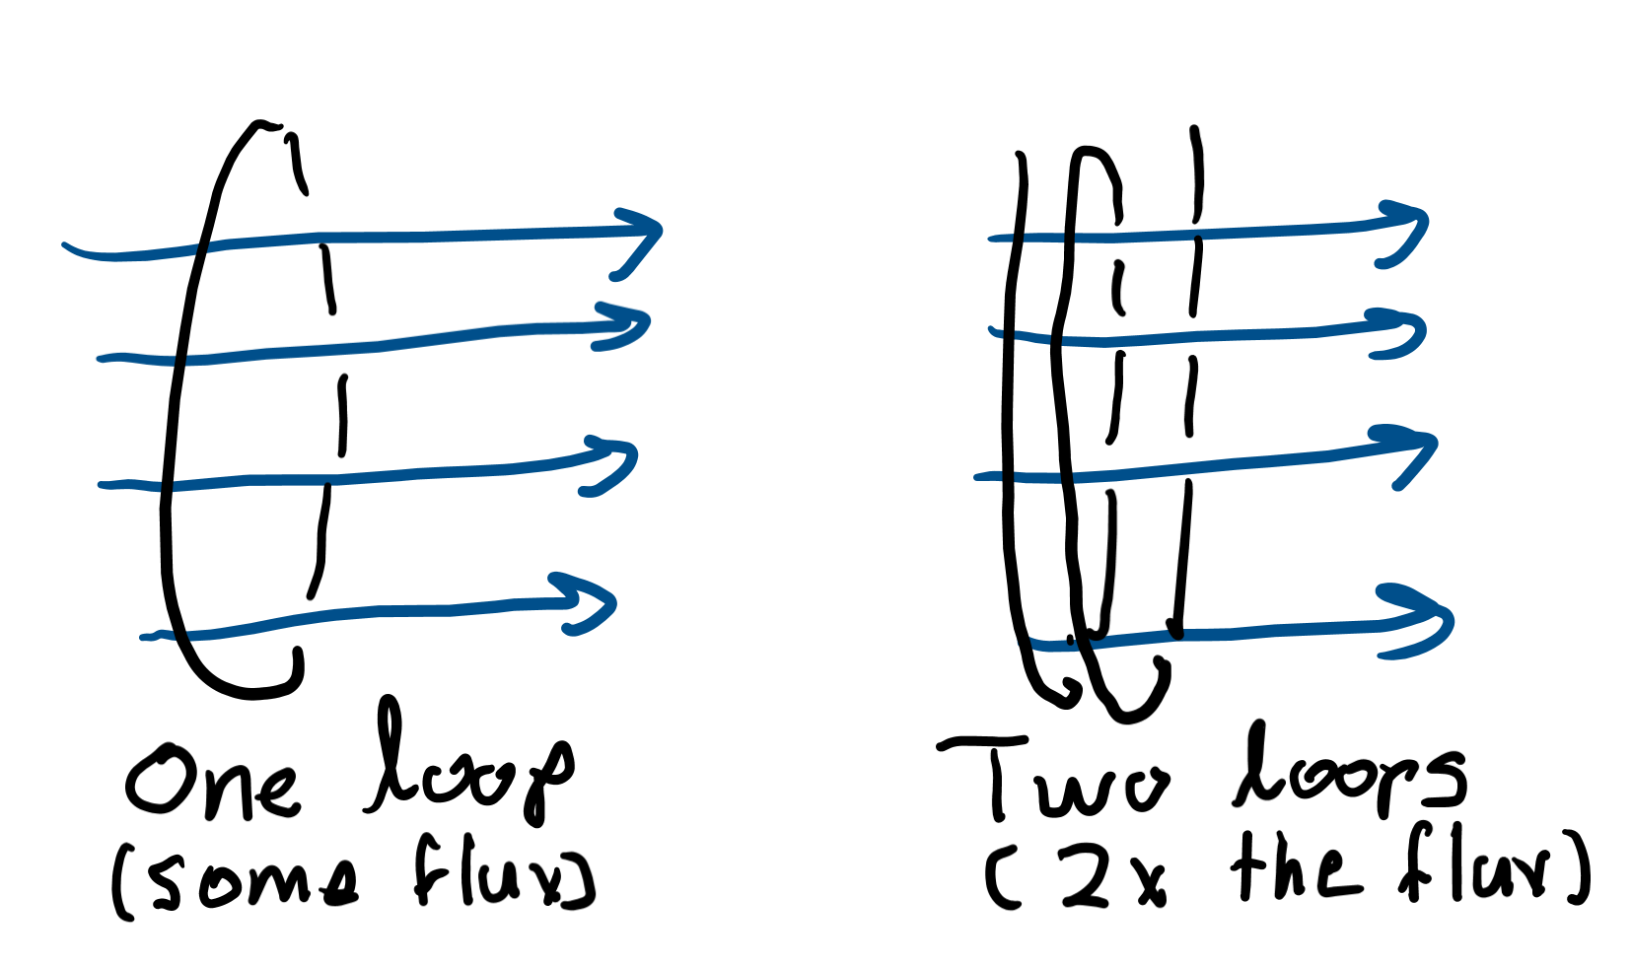
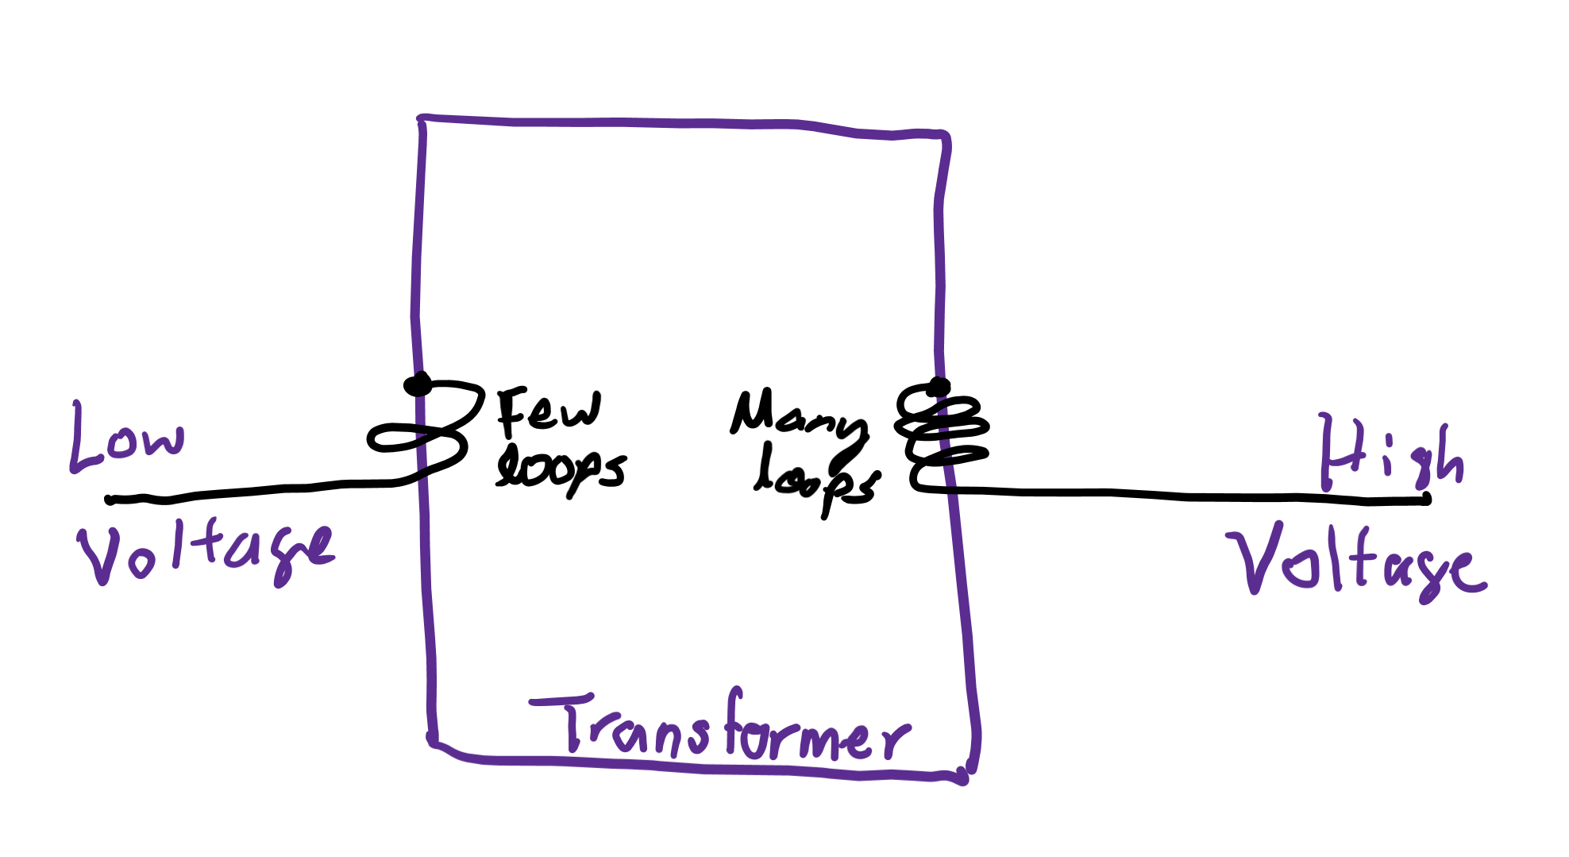
How to change voltage
By induction, the higher the flux, the more EMF (voltage) you get.
We can increase flux by adding more loops! That’s like adding more buckets to catch more rain.
A transformer does this by having a side with more loops and thus more voltage.

Slide 18
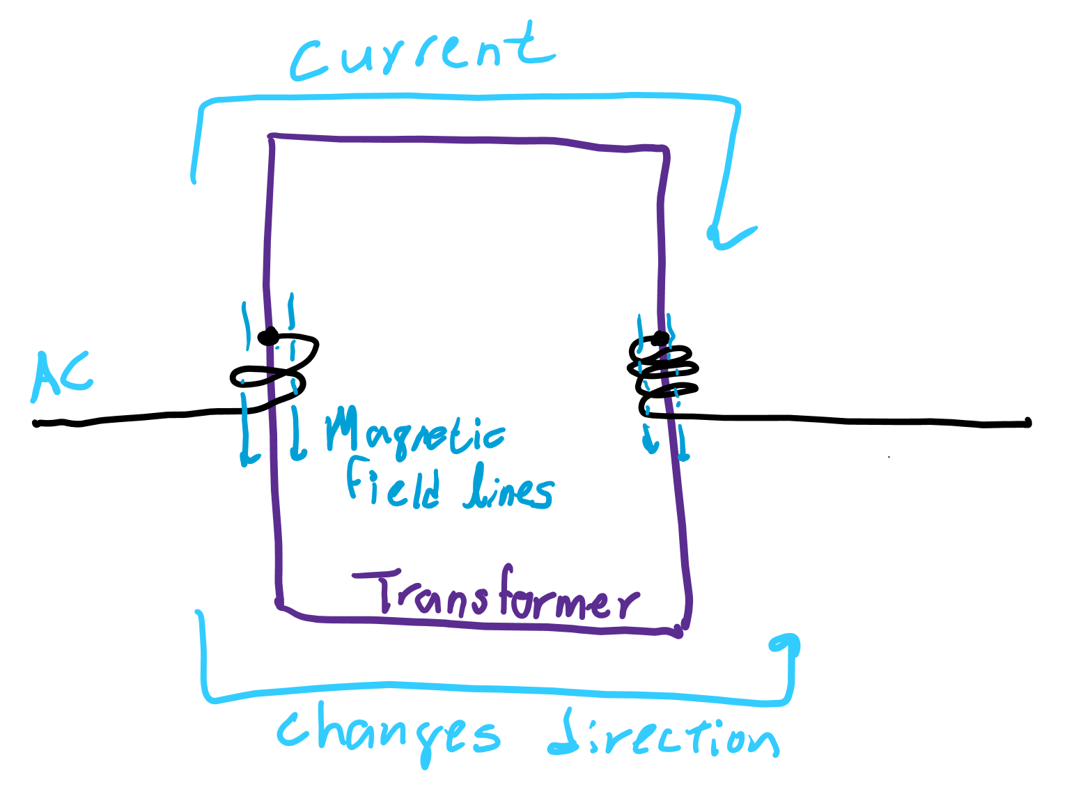
Why it doesn’t work for DC
We get flux only from CHANGING the current. Having a constant current generates NO magnetic field.
DC provides a constant current source, so it cannot generate magnetic flux.

Slide 19
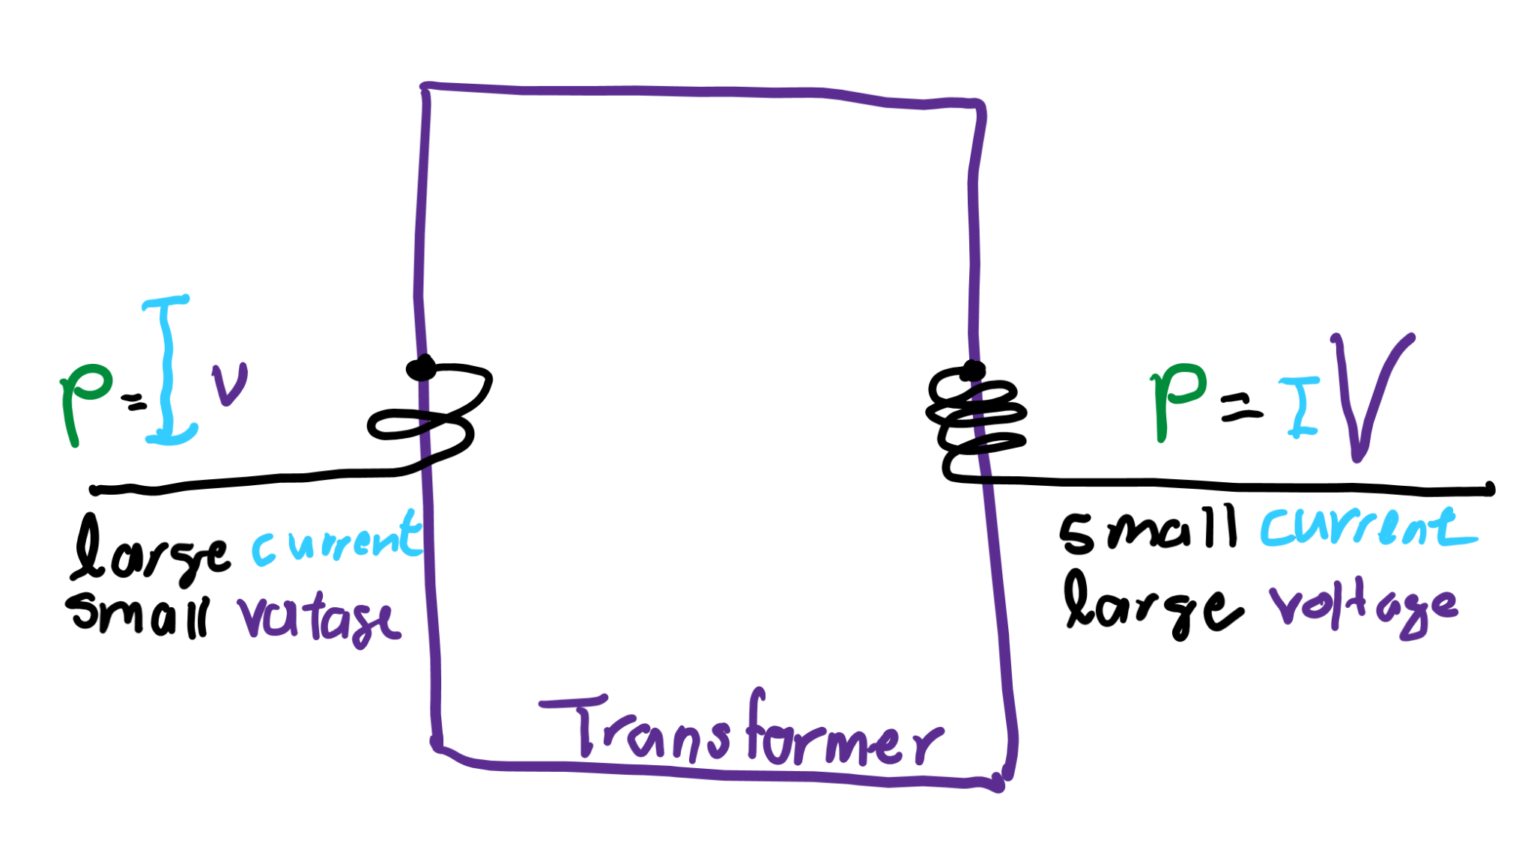
Conservation of energy
Since power is the product of current and voltage, if we increase voltage using a transformer, what happens to power?
Actually power has to stay the same, so current has to decrease to keep power the same!

Slide 20
Diodes

Slide 21
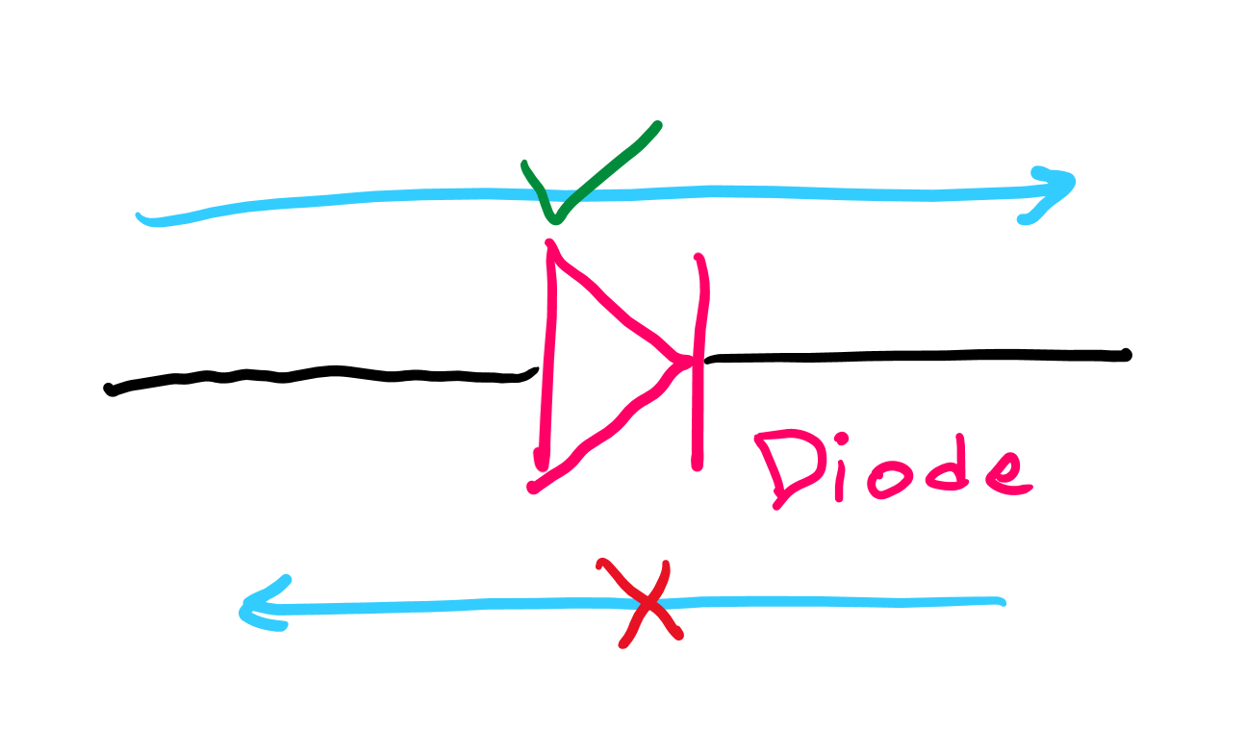
What do they do?
They restrict the current flow to one direction!
What are some potential applications?

Slide 22
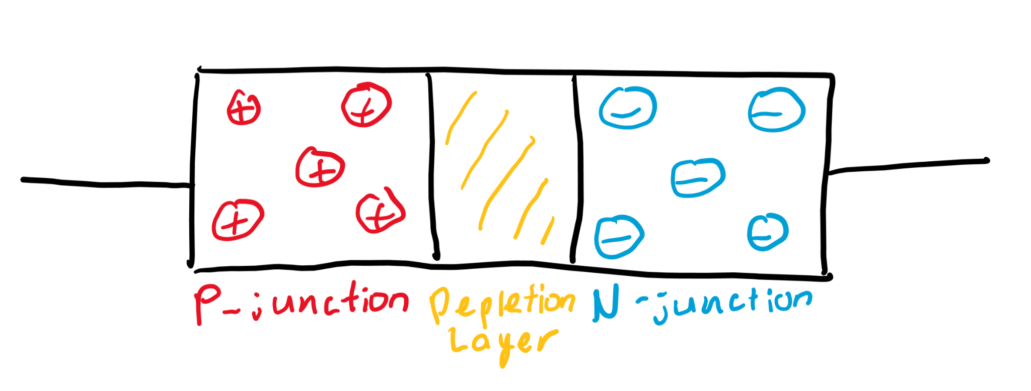
Chemistry *bleh*
They’re made of PN junctions, or one “positive” and one “negative” junction, and current flow through these junctions are easier/harder in certain directions.

Slide 23
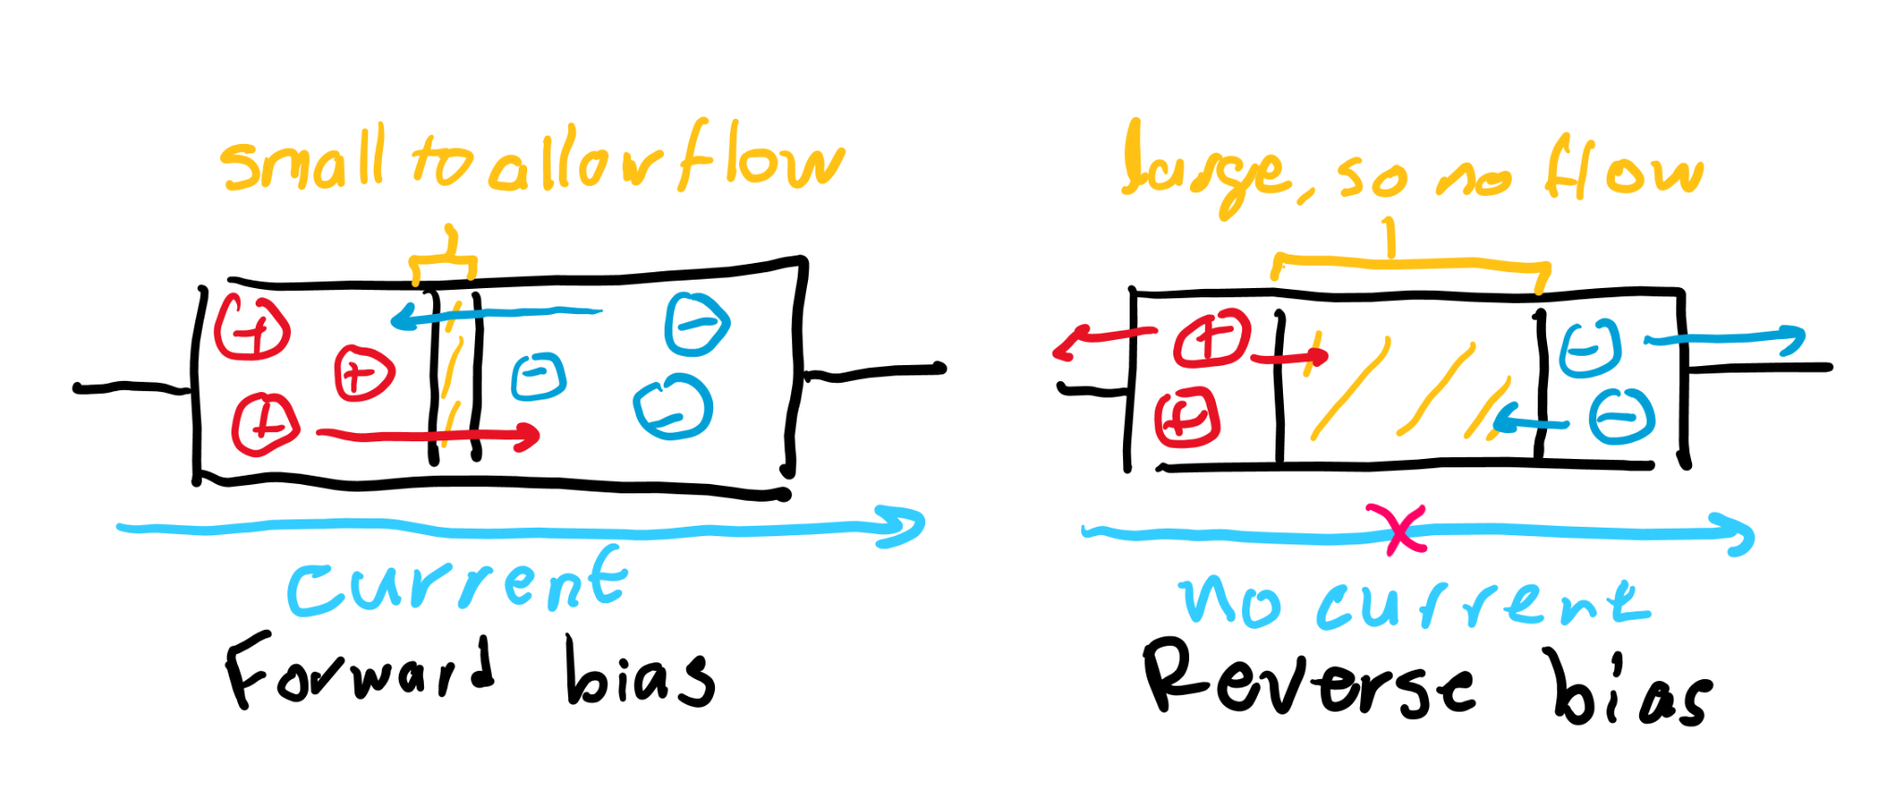
How two PN junctions both make diodes
A forward bias diode allows charge to flow from the p junction to the n junction, causing flow. A reverse bias diode doesn’t let it flow through the depletion layer, so it stops the current.

Slide 24
Rectifiers

Slide 25
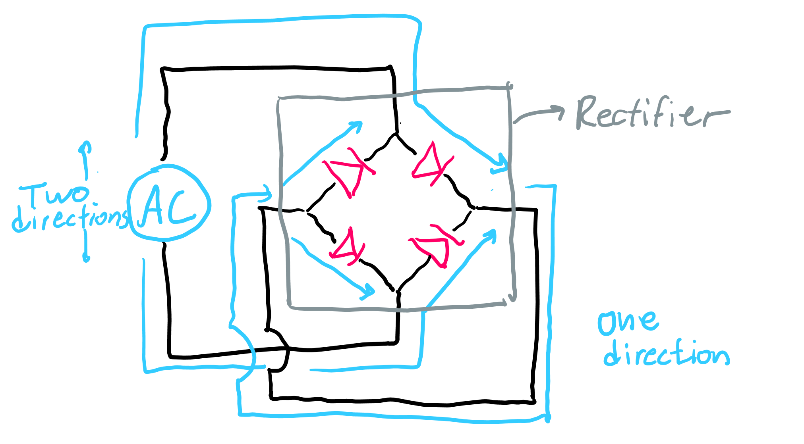
AC to DC
Diodes restrict current to a single direction, but we can do better. We can make alternating current move in a single direction!
By positioning four diodes in a certain way, we can ensure that the current has to flow in this new path. This system is called a rectifier.

